Slide 1
WARNING
These slides are not optimized for printing or exam preparation. These are for lecture delivery only.
These slides contain a lot of animations. For optimal results, watch in slideshow mode.

Slide 2
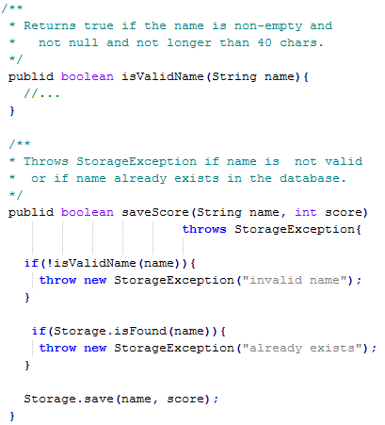
[Oct, 2024]
50 minutes
CS2103/T Week 9
a) Estimate the statement coverage of this method for these three test cases.
Test input | Expected
“new guy”, 0 | success
null , -3 | Name invalid -> exception
“”, 5 | Name invalid -> exception
public
1
2
0%
about 50%
about 80%
100%
3
4
5
b) If all tests of a software pass, and those tests achieve 100% path coverage, (all possible execution paths through the code have been tested), can the software still have bugs?
Notes:
We need to find the statement coverage with the given code.
Need to evaluate each test case and see.

Slide 3
Estimate the statement coverage of this method for these three test cases.
1
Test input | Expected
“new guy”, 0 | success
null , -3 | Name invalid -> exception
“”, 5 | Name invalid -> exception
public
1
2
0%
about 50%
about 80%
100%
3
4
5
Measuring coverage in this case makes us wonder, * Should we add more test cases, cover statement 4?
* Should we reconsider the 3rd test case?
Notes:
The coverage is 80% but statement 4 is not been executed.
Should we add more test cases to cover more?
Test case 3 is not adding value to statement coverage.

Slide 4
2
If all tests pass and those tests achieve 100% path coverage (i.e., all possible execution paths through the code have been tested), can the software still have bugs?
( ) Yes
( ) No
A bug can also be the result of a ‘missing path’ in the code.
High coverage alone cannot guarantee bug free code.
Suppose this is the answer. Then, should we aim for 100% path coverage?
A non-trivial system is likely to have a HUGE number of distinct paths.
Notes:
Although 80% is good, but still there are missing paths. We can have a bug as result of missing paths.
This also tells us that High coverage alone can’t be bug free.
For now, let’s assume 100% coverage. In practice, it is not feasible because of this reason.
When there is loop, then there can be multiple paths – million or billions depending of variable, size limit, etc.
So even a very strong coverage indicator, such as 100% path coverage, it's very hard to achieve, even if it can, then it can’t give guarantee it is 100% free from bug.
Answer: YES

Slide 5


What to consider when deciding if an association is a composition?
3
Foo
Bar
[ ] If Foo objects act as containers for Bar objects, it is composition.
[ ] As long as Bar objects get deleted when Foo objects are deleted, it is composition.
[ ] Concepts represented by the two classes form a whole-part relationship.
[ ] Not always possible to judge from the code alone.
In the exam, there can be additional clues in the description/comments e.g., // a Foo is composed of Bars
This course follows a narrower view of composition, to avoid overuse. Composition tells us ‘this cluster of objects is actually one entity’.
Not a strict UML rule.
Others may differ. When in Rome, do as the Romans do.
What if we make a mistake on this in a real project?
Notes:
Container Relationship: If Foo objects act as containers for Bar objects, this suggests aggregation, not composition. It’s a noise. Aggregation is typically ignored in UML diagrams to avoid unnecessary complexity.
Delete Cascading: If Bar objects get deleted when Foo objects are deleted, this suggests delete cascading, which can result from composition, but it doesn't guarantee it. Delete cascading alone is not enough to confirm composition because it can happen due to many reasons. It moves towards composition, but not enough.
Whole-Part Relationship: The true marker of composition is if the concepts represented by the two classes (Foo and Bar) form a whole-part relationship. This is the key factor in deciding composition. This is the definition of composition.
Beyond Code: Sometimes, it’s necessary to look beyond the code and understand the business logic to identify if a whole-part relationship exists. The relationship should be clear based on the problem the system is solving.
Answer is last 2 choices
Exam Guidance: In exam situations, additional clues will be given to identify compositions, such as comments like, “a Foo is composed of Bars,” to clarify the relationship.
Narrow Definition: In this course, composition is defined narrowly, to indicate a cluster of objects functioning as one entity. This is not a strict UML rule, but a specific interpretation for this course.
Mistakes in Real Projects: Mistaking an association to be composition in a real project isn't catastrophic. If you test well, the incorrect compositions can be detected and fixed during the testing phase, minimizing potential issues. But it’s good if you can figure out correct composition at the beginning.

Slide 6


Context: A software to manage a competition. Contestants are parent-child pairs.
Which class diagram is the best match to the code?
4
class Person {
Person parent;
Person child;
// …
}
The diagram should show the intent of the design, not necessarily a literal translation.
(a)
(b)
parent
parent
Person
Person
Person
child
Person
2 unidirectional associations
child
(c)
parent
a bidirectional association
Person
Is the relationship mutual? i.e., if one Person object is the parent of another, does that make the second one the child of the first, and vice versa?
child
Notes:
Context: The class Person is used to represent parent-child pairs in a software system for managing a competition. The relationship between the parent and child needs to be modeled correctly in a class diagram.
Multiple Class Instances in a Diagram: Option (a) can be ruled out right away because a class diagram should not repeat the same class in multiple places. It's not a proper class diagram structure.
Navigability and Association: The key difference between options (b) and (c) is navigability. Option (b) uses two unidirectional associations, while option (c) uses a bidirectional association.
Mutual Relationship: The decision comes down to understanding whether the parent-child relationship is mutual.
Intent Over Literal Translation: The goal is not to literally translate the code into a diagram but to understand the intent behind the design. What design should have produced this implementation? This gives deeper insight into how to represent relationships.
Best Match: Since the parent-child relationship is mutual in this context, option (c) with bidirectional navigability is the best match to the intent of the design.
Design-First Approach: This example emphasizes that design should inform implementation, and class diagrams are a tool to represent the intent of the design, not just the structure of the code.

Slide 7
Let’s dig in a bit deeper to see how this design works in practice …
class Person {
Person parent;
Person child;
// …
}
Just one parent only?
Donald:Person
Eric:Person
parent=null
child=Eric
parent=Donald
child=null
Know how to recognize this type of mutual relationships
parent
Donald:Person
Eric:Person
child
parent
Note how the design is influenced by the context
Person
child
Context: A software to manage a competition. Contestants are parent-child pairs.
Notes:
Context-Driven Design: In the context of a competition, the design reflects parent-child pairs, with mutual relationships between Person objects.
Bidirectional Relationship: The mutual relationship is bidirectional, where each Person object (parent and child) holds a reference to the other, ensuring the connection between parent (Donald) and child (Eric).
Memory References: The parent and child variables in the code represent memory references that point to each other's respective Person objects, maintaining the relationship.
Design Matches Code: The design correctly matches the implementation, as it allows for a simple, workable representation of parent-child relationships.
Context Influences Design: The context of the problem (e.g., only one parent in the competition) shapes the design decisions, demonstrating how real-world factors influence the implementation.

Slide 8
Note how object diagrams can help figure out (or to verify) class diagrams
class Node{
Node previous;
Node next;
// …
}
n1:Node
n2:Node
n3:Node
previous=null
next=n2
previous=n1
next=n3
previous=n2
next=null
previous
prev.
n1:Node
n2:Node
n3:Node
next
next
previous
Context: doubly-linked list.
Node
next
Notes:
This example is closer to home which is CS concepts.
N1 is previous node of N2 which is next node and so on.
In memory we have something like this.
Object Diagrams as Validation: Object diagrams can be used to increase confidence in the design by showing a more concrete view of how objects interact during runtime.
Class-Object Cross Verification: Since object diagrams and class diagrams should match, they can be used to cross-verify each other
Work Backwards from Object Diagrams: Designers can start with the object diagram to understand relationships and then work backwards to create the appropriate class diagram.

Slide 9

Which class diagram is the best match for the code?
class Person {
Person twin;
// …
}
A bi-directional association can be implemented using only one variable too (if both play the same role)
(a)
(b)
twin
twin
Person
Person
Luke:Person
Leia:Person
twin=Leia
twin=Luke
Notes:
Bi-directional Relationship: The relationship between twins is mutual, meaning if one person is a twin, the other person must also be their twin, representing a bi-directional association.
Single Variable for Mutual Roles: In this case, although the relationship is bi-directional, it is implemented using just one variable (twin) because both ends of the relationship play the same role.
No Need for Two Variables: Unlike other cases where two variables may represent a bi-directional relationship, this example only needs one variable, simplifying the design while maintaining bi-directionality.
Answer: The best match for this class diagram is option (a), as it correctly represents the mutual relationship between the twins with a single variable.

Slide 10

Which class diagram is the best match for the code?
class Person {
Person bestFriend;
// …
}
(a)
(b)
bestFriend
bestFriend
Person
Person
bestFriend
bestFriend
Kevin:Person
Gary:Person
Quinn:Person
Notes:
How about now? Is it bidirection?
Not really right – it should be able to accommodate this kind of scenarios.
Gary is the best friend of Kevin, but Quinn is the best friend of Gary - so it's not mutual sometimes.
So the answer is B, which is not bidirectional association.

Slide 11
class Person {
Person twin;
// …
}
class Person {
Person bestFriend;
// …
}
twin
bestFriend
Person
Person
Reminders:
Just the code may not be enough to draw the matching UML diagram.
Auto-generated UML diagrams may not be ideal.
Notes:
In the past 2 examples – they are same except the name of the object – because of this, we have two different relationship.
So, when you draw the UML diagrams, don’t just look into the code alone, instead – find the meaning of the relationship and then decide.
There are tools can generate diagrams, but they can’t figure the meaning of the relationship and which one is correct or ideal. So this is one reason.

Slide 12

Which class diagram is best? All correct, all about the same design, just different levels of details
(a)
(b)
first
Foo
Bar
Foo
Bar
1..*
1..*
last
Goo
Goo
1
1
(c)
Foo
Bar
(d) It depends on the purpose of the diagram
Notes:
Which one is correct?
Answer is D
Level of Detail: Diagrams can vary in the level of detail they present, from minimal to highly detailed. The choice depends on how much detail is needed for the given context.
Purpose-Driven: The best diagram depends on its purpose. If a particular class or relationship is irrelevant to the purpose, there's no need to include it.
Custom vs. Auto-Generated Diagrams: Auto-generating diagrams is not always optimal because the tool won’t know the specific purpose and may include unnecessary details.

Slide 13

Which sequence diagram is wrong?
(a)
(b)
:Foo
:Bar
:Foo
:Bar
(c)
(d) None. All are correct
:Foo
:Bar
Notes:
– is wrong because the activation bar should be continued until the end.
(c) – its ok to omit the activation bar.

Slide 14

FYI: This kind of non-continuous activation bars are used to show asynchronous method calls (i.e., the caller doesn’t block until the called method returns).
But not in scope of this course.
:Foo
:Bar
Notes:
Synchronous Method Calls: In Java (and most languages), method calls are typically synchronous, meaning the calling method waits for the called method to finish before proceeding.
Asynchronous Method Calls: Asynchronous calls allow the calling method to continue doing other tasks without waiting for the called method to return, common in web applications (e.g., JavaScript).
Activation Bars: In synchronous calls, the activation bar continues until the called method returns. In asynchronous calls, it would stop until the method returns.
Not in Scope: Asynchronous method calls and the differences in arrowheads for synchronous vs. asynchronous calls are not covered in this course, so they won’t be examined.

Slide 15

A statement in the code can be covered by these:
Unit testing
Integration testing
System testing
Smoke testing
Acceptance testing
Alpha/beta testing
Regression testing
TDD
Can be done in hybrid mode (i.e., combined)
Why not just do this one?
Too late
Too costly
Too slow
Doesn’t test some things
Notes:
Recap of all types of testing:
Unit Testing: This is about testing small things in isolation.
Integration Testing: This is for testing interaction. This and (1) can be done together in a systematic manner. It is important to test parts of the system early. These tests are faster, cheaper, and can target specific issues or deeper corner cases, which system testing may miss.
System Testing: It tests the entire system through external interfaces. But it can be slow, costly and involve more people. Also it might not cover specific internal scenarios or corner cases effectively. So still we need (1) and (2).
Different Types of Testing: Various tests (smoke, acceptance, alpha/beta, regression) focus on the entire system for different purposes. Each type of test helps cover different aspects of the system. Regression testing is wide range testing – repeat the test after that change.
TDD (Test-Driven Development): This is an approach where tests are written before the code. It can vary in practice across companies, but it's useful to know as a methodology. It’s good to know.
Answer: All of these. – This question is to talk about different types of testing.

Slide 16

Dependency injection is most related to:
Unit testing
Integration testing
System testing
Notes:
Dependency Injection: It refers to replacing a component's dependency by injecting an alternative, typically during testing or runtime, allowing flexibility.
Unit Testing Context: Dependency injection is particularly useful in unit testing, where isolating the component under test from its dependencies is critical.
Mocking/Stubbing Dependencies: In unit tests, dependencies can be replaced with mocks or stubs to simulate behavior, making tests more reliable.
Mostly for Unit Testing: While dependency injection can be used in other testing types, it's most beneficial for unit testing scenarios.
Answer: Unit Testing

Slide 17
Preview of next week

Slide 18
Covered in quiz part 1 (immediate answers). Used for the next week’s tutorial
Notes:
Last installment of the UML – easier installment
Have to do this before the tutorial – quiz is part 1 and part 2.
Part-1 covers these two topics and also you can check the answers.

Slide 19
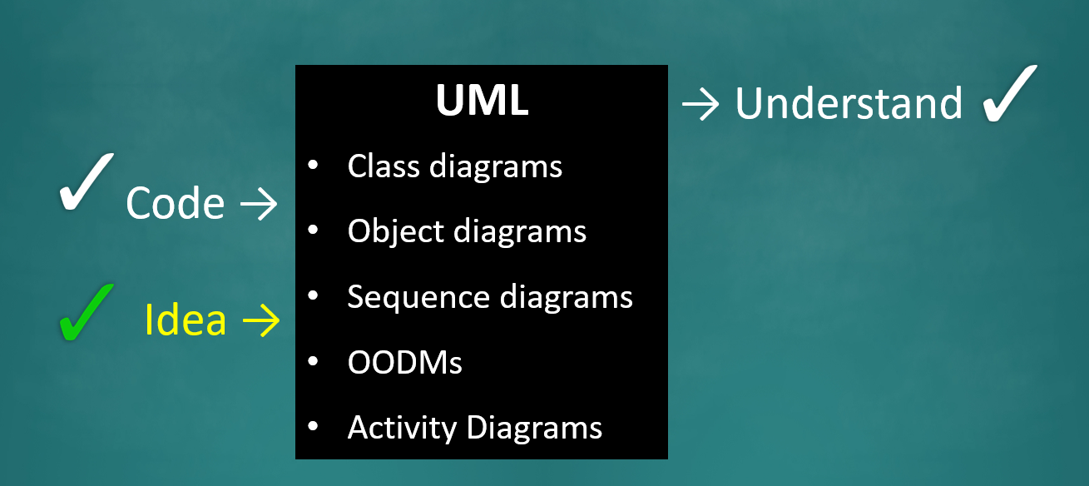

Notes:
So far – learned how to interpret code, draw diagram for code, etc. Now we focus on how to draw UML to conceptualize a design.
You have to come up with the model/diagram first.

Slide 20

UML
Class diagrams
Object diagrams
Sequence diagrams
OODMs
Activity Diagrams
→ Understand
Code →
Idea →

Slide 22

experience
… is what you get when you didn’t get what you wanted.
Notes:
You often learn more by making mistakes - if you make a mistake, and if you don't learn anything that that's bad right?
And you don't get things right the first time,So this happens and we grow over time by gaining experience.
“Sometimes we win,
Sometimes we learn”

Slide 23
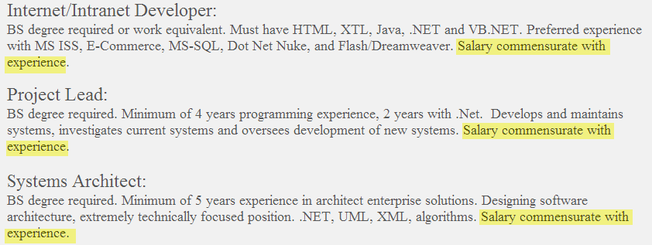
experience
… is valuable.
Notes:
That’s why more experienced people are paid more.
Not because they know more syntax, it's because they have made their mistakes somewhere else, someone else has paid the price and they learned from the mistakes
Companies can afford to pay them more because they won't make those mistakes again. Hopefully.
So experience is valuable.

Slide 24

experience
Learning from
… is too costly.
Notes:
Too costly to learn everything from mistake

Slide 25
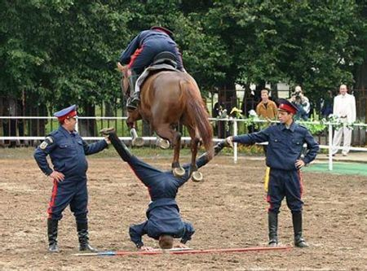

experience
Learning from
Note to self: never volunteer to be the headstand guy
Notes:
Instead learn from others experience :)
If there is way for us to learn from others, then that’s much better.

Slide 26

Gems of Wisdom:
Software Engineering Principles.
Notes:
People have made the same mistake over and over again.
After a while they figure out that, we should do it this way or that way.
And this is wisdom and the knowledge, which is captured into what we call principles. Right?
Then it's we can learn them and follow them without making the mistakes ourselves

Slide 27

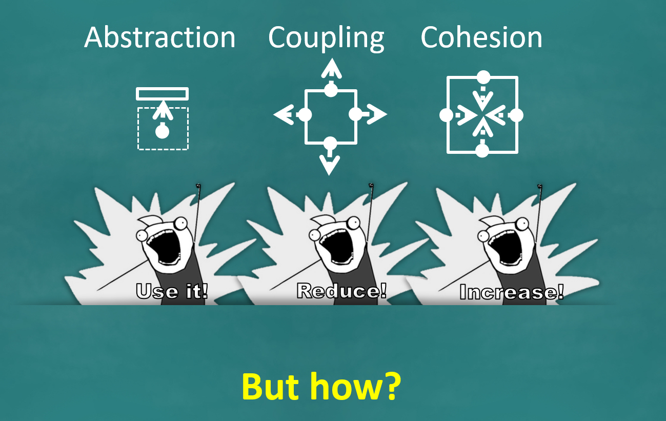
Design Principles
These build on top of the three fundamental design concepts: …
SoC: Separation of Concerns
LoD: Law of Demeter
SOLID Principles
SRP – Single Responsibility Principle
OCP – Open-Closed Principle
LSP – Liskov Substitution Problem
ISP – Interface Segregation Principle
DIP – Dependency Inversion Principle
DRY: Don’t Repeat Yourself
YAGNI: You Aren’t Gonna Need It!
There are other types of principles too ...
Notes:
In SE, we also have principles that is called as design principles – some of them are known to you.
Cover 5 of them in this course and tested for exam – and few others are covered, but not tested in exams.
Where do they fit?
Abstraction - We should use the right abstraction, Very important
coupling - we should try to minimize it.
cohesion – good, must increase.
So, all those are good advice. But how exactly are we going to do this? This is where design principles come in.
They can help you in certain situations. If you do it like this, it will be a better abstraction. It will be less coupling, it will be more cohesive.

Slide 28
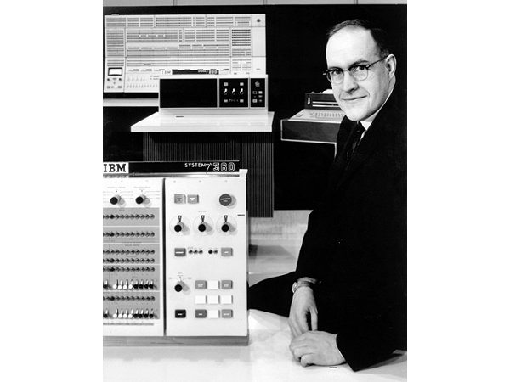
Notes:
Historical Context: In the early days, IBM was the dominant company in technology, long before companies like Microsoft or Google existed. The story revolves around an IBM project to build the System/360 operating system.
Project Failure: The project was a disaster, but the leader of the project, Fred Brooks, learned from the mistakes made during its development.

Slide 29
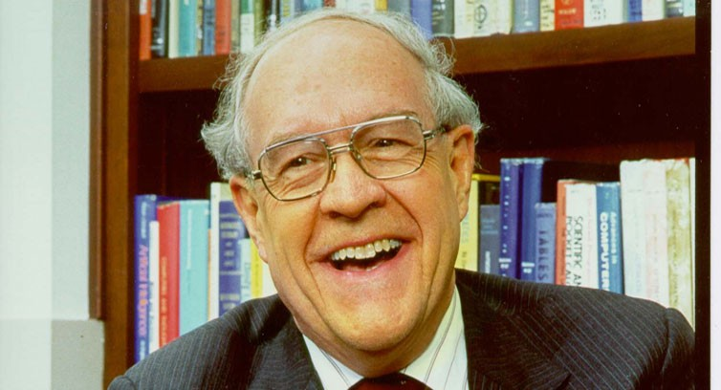

Prof. Fred Brooks, Jr.
Brooks's law :
Adding manpower to a late software project makes it later.
Plan to throw one (implementation) away; you will, anyhow.
The second system is the most dangerous system that an architect ever designs.
The bearing of a child takes nine months, no matter how many women are assigned. Many software tasks have this characteristic too ...
Notes:
The Famous Book: Fred Brooks later wrote a well-known book, "The Mythical Man-Month," capturing the lessons and principles he learned from the project failure.
Brooks' Law: One key principle from the book is known as "Brooks' Law," named after the author
Guess which is the Brooks Law? You are not supposed to know this.
Answer: "adding more manpower to a late software project makes it later.”
Other choices are also from same book – they are very interesting to know.

Slide 30
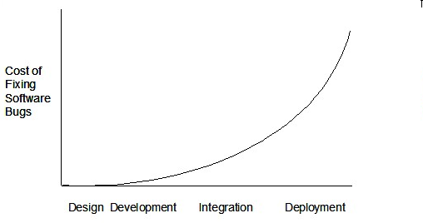
The later you find a bug, the more it costs
Notes:
This is another principle which is related to testing, you encountered before.

Slide 31
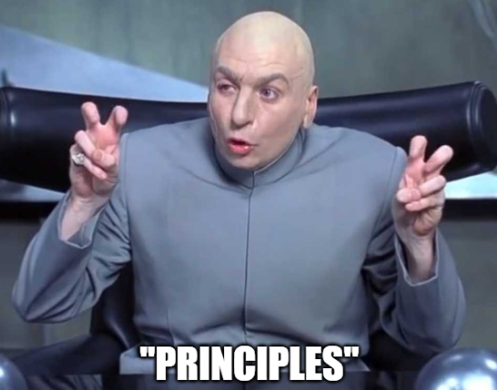
[extra] Good, cheap, fast: select any two
Good
Cheap
“Principles” vary in rigor, depth, credibility …
Fast
Notes:
If you want software to be good and you want it quickly - it's not going to be cheap. You had to hire the best people and pay them well.
You cannot get all 3 at the same time, only 2 of them.
So I want to tell you that these principles vary in terms rigor, depth, credibility, etc.

Slide 32

“
”
Some principles are nicely captured in famous quotes
-- me
E.g.
The first 90% of the code accounts for the first 90% of the development time...The remaining 10% of the code accounts for the other 90% of the development time. -- Tom Cargill
More SE quotes https://www.comp.nus.edu.sg/~damithch/pages/SE-quotes.htm
Notes:
These principles are short – so that we can memorize them.
Some of them are funny and interesting to know - This tells us that when you think you have written about 90% of the code - You might think you are 90% done with the project. No, you are like halfway. There's another 50% of the work to be done, because the last 10% is the hardest.
Overtime, you will learn that you need to allocate more time for the last stretch of the project.
Sometimes, not all the principles are not as good as others.

Slide 33



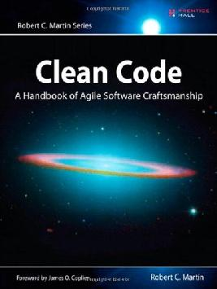
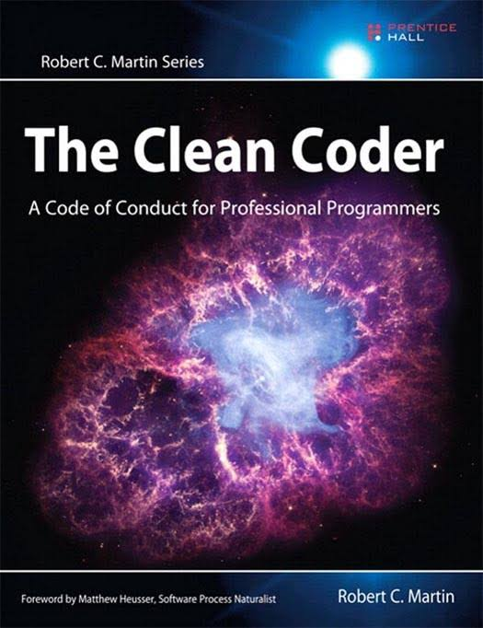
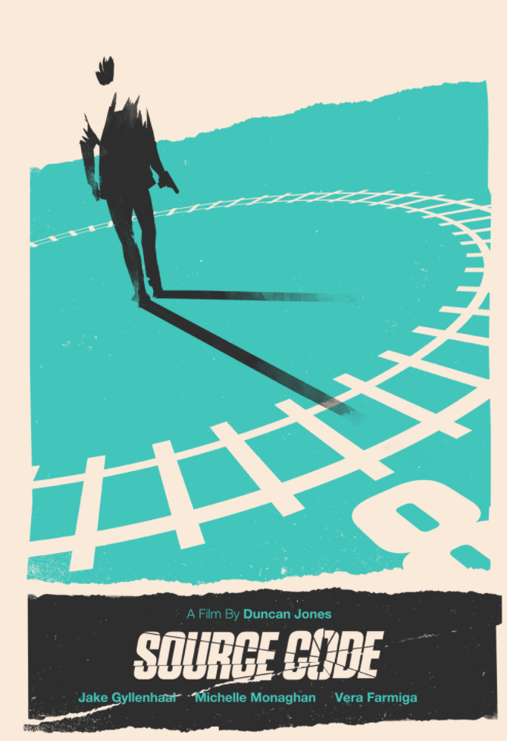

Which of these is NOT a book containing practical SE ‘wisdom’?
Notes:
Where to find the good principles that are credible?
Books – they are bigger investment and take more time and investment to publish a book – so they are more credible than blogs, forums, websites, etc.
Here are some examples of more credible books – all are books except last one which is a movie.
Answer: Last one.

Slide 34
Notes:
That’s about design principles.

Slide 35
Notes:
We also read about SDLC models – learned two models which are building blocks.
We will continue of this.

Slide 36
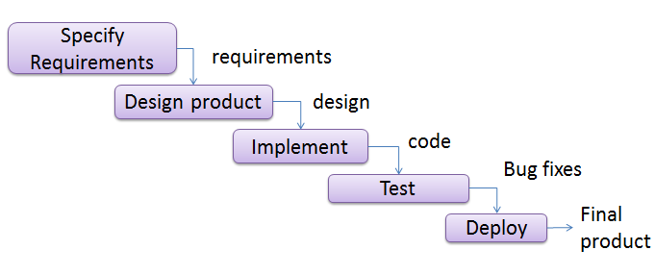
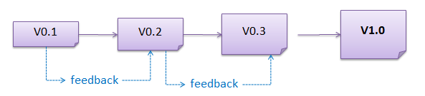



Building blocks
Sequential
[aka waterfall]
Iterative
(breadth-first)
Iterative (depth-first)
Notes:
There we learned these two models which are building blocks.

Slide 37







Sequential Iterative
breadth-first depth-first
Actual process models
Notes:
The actual models used in Industry have different names like these: scrum, agiles, ExP, etc. You will learn these topics.

Slide 38
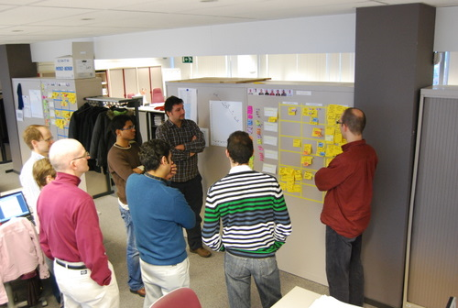


Sequential Iterative
breadth-first depth-first
Actual process models
Notes:
You will also learn about scrum meeting – standup meetings which are very short meeting and each person will talk about 3 things. You will find them in the lecture videos.

Slide 39

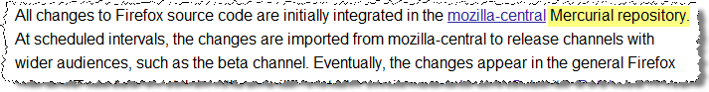

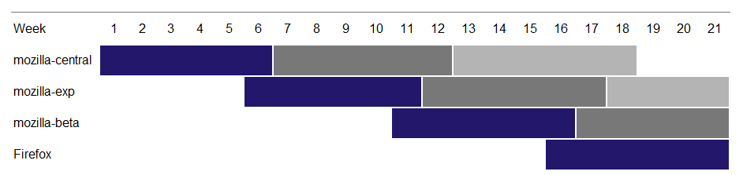
In the video only
Some example processes used in well-known companies …
http://mozilla.github.com/process-releases/draft/development_overview/
Notes:
In the video, Prof.Damith had commented on certain practices which are used in some projects and companies – not tested in exam, but you can watch them.
Mozilla is a huge open source project. They have several code repos.
[afterclick] After extensive code reviews and testing, the code is moved forward to more stable repos, eventually reaching the production repo that is released to the public.
[afterclick]This process can take months.

Slide 40
Notes:
So that’s about the SDLC models.

Slide 41
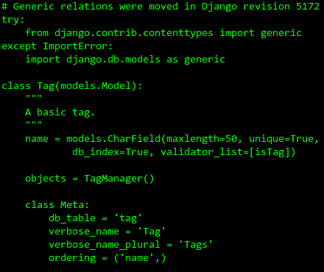
<code> RULES!!!</code>
Notes:
Code as the Ultimate Description: Code is the most accurate and detailed description of the system. However, reading through all the code can be overwhelming.
Why we need other description of system.

Slide 42
<code> RULES!!!</code>

Slide 43
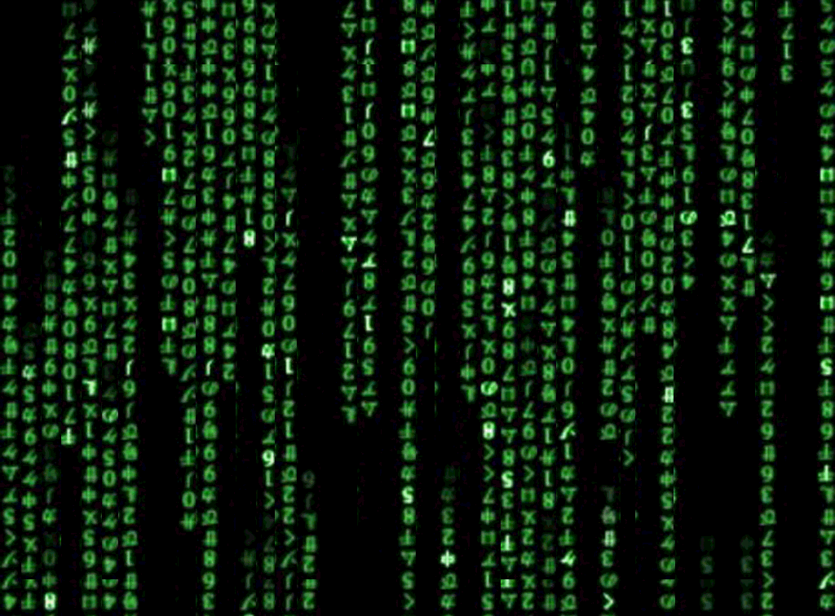
Notes:
There are too much to read.

Slide 44



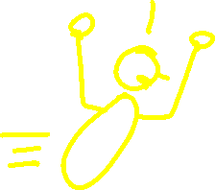

Notes:
Challenge with Large Codebases: For new programmers joining a big project, diving straight into the code to understand the system's architecture isn't practical.
Importance of High-Level Design: High-level design or architecture gives a broader picture of the system and is a better starting point than reading the entire code.
Why Architectural Diagrams Matter: Even though the code follows the architecture, using diagrams or documentation to present the architecture is more efficient than reading the code for new team members.

Slide 45
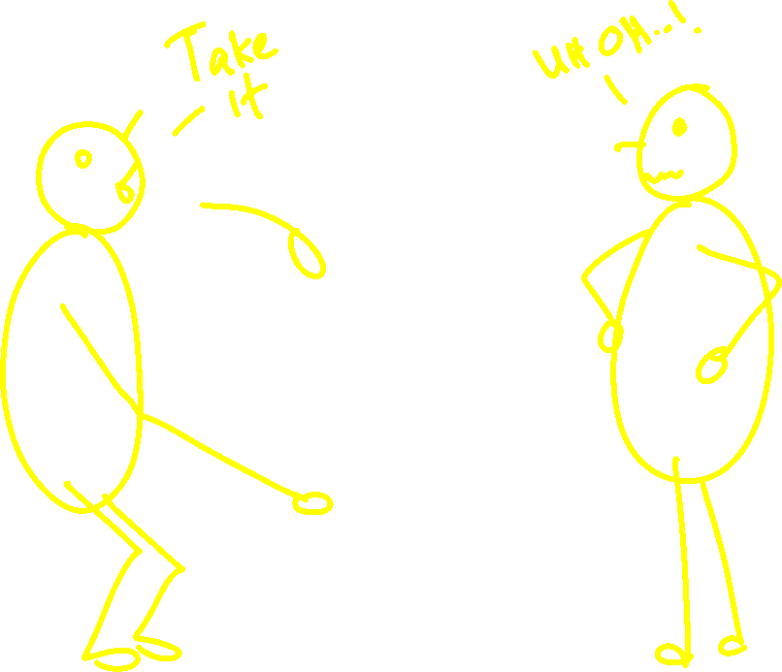
Notes:
In your career, you may want to hand-over your codes/project to others and move to other project.
You should not sit in one project for long time.
If you are a bad programmer, then someone will take over your code and this can happen.
This someone can play an important part in your career.

Slide 46
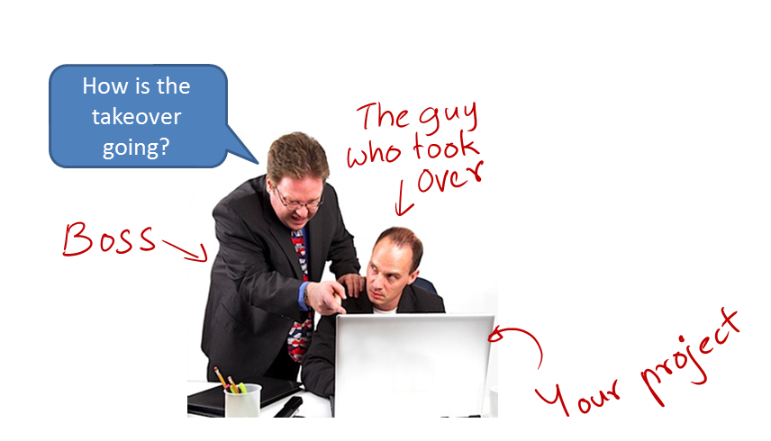
“Always code as if the guy who ends up maintaining your code will be a violent psychopath who knows where you live”
Notes:
The guy who took your code will be working on your code.
Boss/PM – will ask “Why is it taking so long for this?”
That guy will say “Who wrote this code? So crappy, buggy, etc.” He basically tore your career apart.
You can’t even explain to Boss because you were in some other project.
The boss may have bad impression on you and impacts your promotion.
When someone takes over your code, we have to do our very best to help him to understand our code. So how do we explain the code to this someone when you are not near them, explaining them about your code?
This is where the developer documentation comes in.

Slide 47






How is the takeover going?

Slide 48

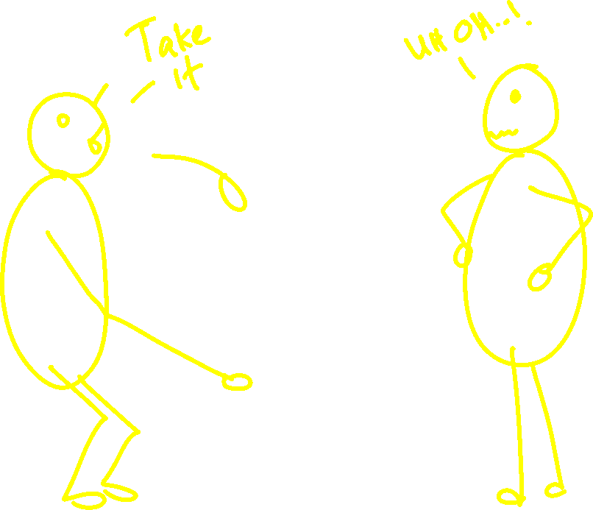

Slide 50

Developer documentation,
a necessary evil
should be done with maintainability in mind
should be minimal yet sufficient
should include volatile/low-level details
Notes:
Developer Documentation is a necessary evil, we should have it.
We also need to maintain over time – should not take more time to update them. They should be easy to maintain than code.
And also should be minimal – so easy to read and understand it.
Don’t put all the low-level details unless it is auto-generated.
Answer: First 3 choices.

Slide 52
Aim to create a working MVP by this deadline
Notes:
Demoable Version Expected: By this week, you are expected to produce something demoable. If you followed the guidelines, you should be nearly done with the first iteration.
Iterative Approach: If you split your 1.2 feature into two iterations, you should be almost ready with the first, which should already be demoable.
Time to Push: With midterms over and finals still ahead, this is the time to focus and push as much work as possible in the coming weeks.
Relax after Milestones: Once the demoable version is ready, you can relax a bit, but use the remaining time to improve and progress further.

Slide 53
One more general advice [5 minutes]
No direct relation to grading!

Slide 54
How will generative AI tools impact SE careers?
Right now: not much.
In a few years time: could be significant.
Possible for a person to create (and maintain) software using natural language instructions only,
with no hands-on involvement and no technical knowledge? Unlikely.
with some hands-on involvement from developers? Yes.
Would that mean fewer SWE jobs? Very likely.
The work profile will change too.
Skills needed to survive?
Deep AI knowledge? For some
Prompt engineering? Sure.
Deep tech expertise? Yes.
Evaluative judgement skills? YES.
Keep up with AI tools (e.g., use them)
Practice making evaluative judgements
Notes:
Current Impact of AI Tools: Right now, generative AI tools like ChatGPT and Copilot are impressive but not enough to replace software engineers. In a few years, however, the impact could be significant.
Fast Evolution: These tools have shown rapid improvements in just a short time, and it is likely that they will continue to evolve, though perhaps at a slower pace. The tools are helping already – but can’t do the task without human in the loop.
AI as a Junior Developer: In the future, software engineers might work more as managers of AI tools, similar to guiding junior developers, which will demand higher levels of expertise from the start.
Potential Job Changes: Overall effect of this in recent drop in hiring is due to the covid pandemic – over hiring – nothing to do with the AI.
The number of software engineering jobs (highly paid jobs) could decrease as AI tools take on more of the work. This doesn’t mean fewer jobs overall, but the work profile will shift, requiring different skills. Again this is not bad news, instead this, there will be new demand created. There will be other kind of high-paid jobs that will be created - software engineers will need deep technical expertise to identify subtle issues in AI-generated code.
Evaluative Judgement: One of the most critical skills to survive in the evolving landscape is the ability to make fast and accurate evaluative judgments on code quality and design.
Prompt Engineering: Interacting with AI through prompts will become essential, but this is expected to be easier to learn compared to other skills.
AI Knowledge for Some: Deep AI knowledge will be needed only for those working on developing these tools, but a foundational understanding of AI will still be valuable for most engineers.
Keep Up with AI: Don’t ignore AI tools; experiment with them to stay updated and understand their capabilities.
Developing Expertise: Despite the shift toward reviewing and guiding code, it's still essential to write code to build deep expertise. Successful engineers will need both coding and evaluative skills.

